Slide 1
Diagram Factory Unit Test
Betty Felenchak
Amy Tran
Kai Deng

Slide 2
Table of Contents
Unit Tests 1-8
Appendix A: Ecore files used in unit test
Appendix B: How to do unit test of DiagramFactory.java

Slide 3
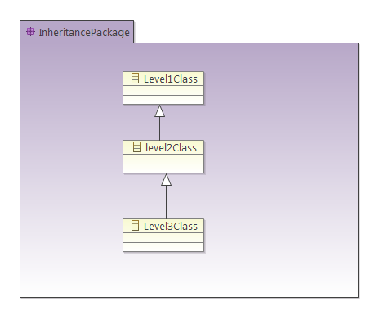
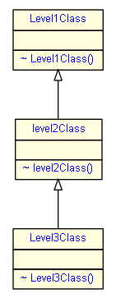
Test 1: Objective: Test Inheritance by having three levels of inheritance
Picture of Class Diagram generated in Eclipse EMF
Picture generated in Diagram Factory
Result: Passed.
Notes: ClubUML does not draw the package box around the classes (UMLGraph does not seem to have that ability.)
EcoreFile: ThreeLevelsInherit.ecore

Slide 4
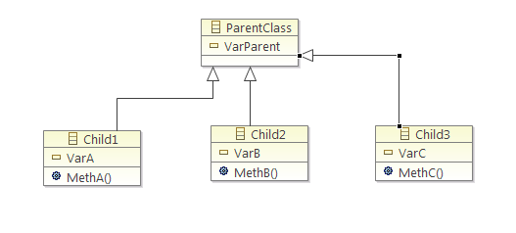
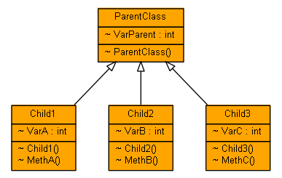
Test 2: Objective: Test Inheritance by having three classes inherit from same class.
Picture of Class Diagram generated in Eclipse EMF
Picture generated in Diagram Factory
Result: Passed.
EcoreFile: ThreeChilds.ecore

Slide 5
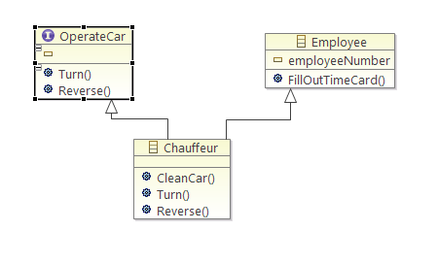
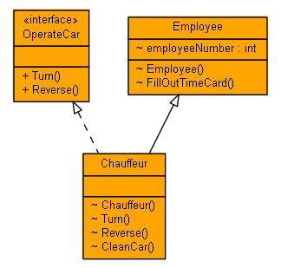
Test 3: Objective: Test interface by having a class inherit from a class and an interface
Picture of Class Diagram generated in Eclipse EMF
Picture generated in Diagram Factory
Result: Passed.
Notes: The EMF diagram doesn’t show <<interface>> or make lines dashed, but the Diagram Factory does
EcoreFile: ThreeLevelInterface.ecore

Slide 6
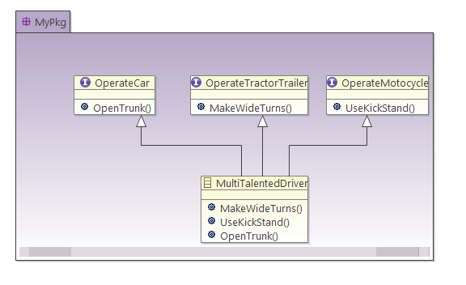
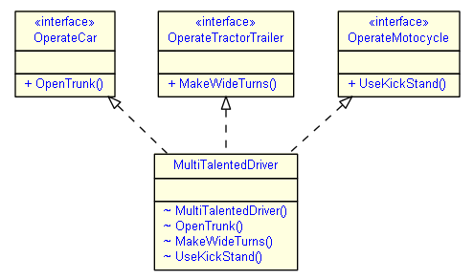
Test 4: Objective: Test interface by having a class implement multiple interfaces
Picture of Class Diagram generated in Eclipse EMF
Picture generated in Diagram Factory
Result: Passed.
Notes: The EMF diagram doesn’t show <<interface>> or make lines dashed, but the Diagram Factory does
EcoreFile: MultiInterfaces.ecore

Slide 7
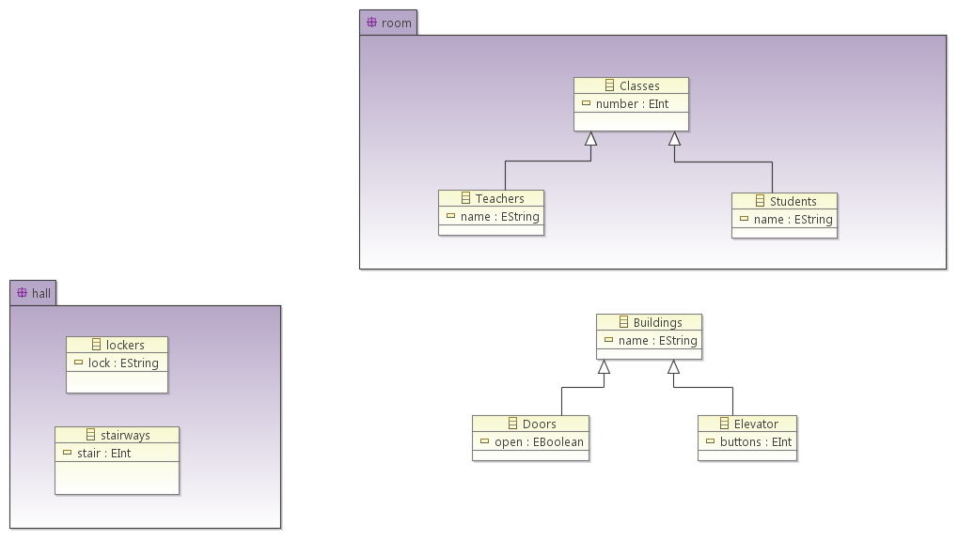
Test 5: page 1 Objective: Test packages and classes at same level within default package
Picture of Class Diagram generated in Eclipse EMF

Slide 8
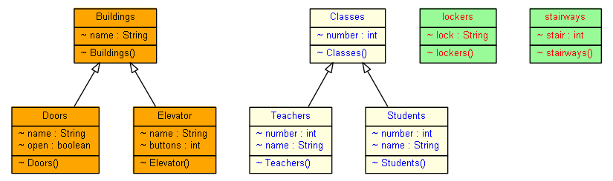
Test 5: page 2
Picture generated in Diagram Factory
Result: Passed.
EcoreFile: school.ecore

Slide 9
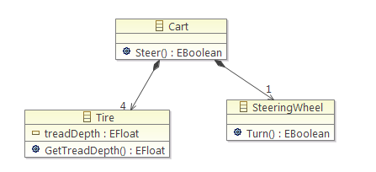
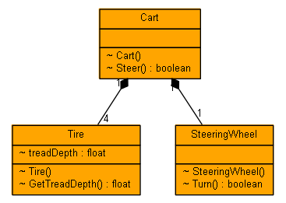
Test 6: Objective: Test composition by having a class that is composed of two other classes
Picture of Class Diagram generated in Eclipse EMF
Picture generated in Diagram Factory
Result: Passed.
EcoreFile: Composition2.ecore

Slide 10
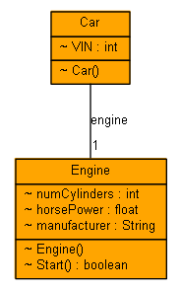
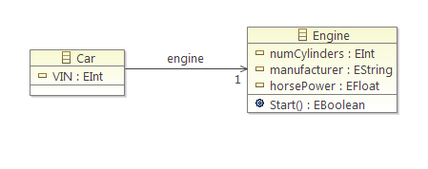
Test 7: Objective: Test references by having a class that has a reference to another class (not composition)
Picture of Class Diagram generated in Eclipse EMF
Picture generated in Diagram Factory
Result: Passed.
Note: Can’t figure out in emf how to have multiplicity at other end.
EcoreFile: Reference.ecore

Slide 11
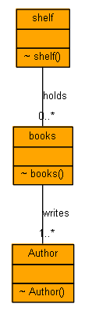
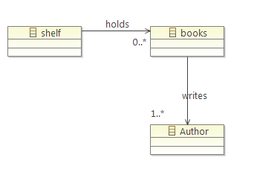
Test 8: Objective: Test multiplicities
Picture of Class Diagram generated in Eclipse EMF
Picture generated in Diagram Factory
Result: Passed.
Note: Can’t figure out in emf how to have multiplicity at both ends.
EcoreFile: Relationship.ecore

Slide 12
Appendix A: Ecore Files used in the Unit Test

Slide 13
Test1
ThreeLevelsInherit.ecore
<?xml version="1.0" encoding="UTF-8"?>
<ecore:EPackage xmi:version="2.0" xmlns:xmi="http://www.omg.org/XMI" xmlns:xsi="http://www.w3.org/2001/XMLSchema-instance"
xmlns:ecore="http://www.eclipse.org/emf/2002/Ecore" name="threelevelsinherit" nsURI="http://threelevelsinherit/1.0" nsPrefix="threelevelsinherit">
<eSubpackages name="InheritancePackage">
<eClassifiers xsi:type="ecore:EClass" name="Level1Class"/>
<eClassifiers xsi:type="ecore:EClass" name="level2Class" eSuperTypes="#//InheritancePackage/Level1Class"/>
<eClassifiers xsi:type="ecore:EClass" name="Level3Class" eSuperTypes="#//InheritancePackage/level2Class"/>
</eSubpackages>
</ecore:EPackage>

Slide 14
Test2
ThreeChilds.ecore
<?xml version="1.0" encoding="UTF-8"?>
<ecore:EPackage xmi:version="2.0" xmlns:xmi="http://www.omg.org/XMI" xmlns:xsi="http://www.w3.org/2001/XMLSchema-instance"
xmlns:ecore="http://www.eclipse.org/emf/2002/Ecore" name="threechilds" nsURI="http://threechilds/1.0" nsPrefix="threechilds">
<eClassifiers xsi:type="ecore:EClass" name="ParentClass">
<eStructuralFeatures xsi:type="ecore:EAttribute" name="VarParent"/>
</eClassifiers>
<eClassifiers xsi:type="ecore:EClass" name="Child1" eSuperTypes="#//ParentClass">
<eOperations name="MethA"/>
<eStructuralFeatures xsi:type="ecore:EAttribute" name="VarA"/>
</eClassifiers>
<eClassifiers xsi:type="ecore:EClass" name="Child2" eSuperTypes="#//ParentClass">
<eOperations name="MethB"/>
<eStructuralFeatures xsi:type="ecore:EAttribute" name="VarB"/>
</eClassifiers>
<eClassifiers xsi:type="ecore:EClass" name="Child3" eSuperTypes="#//ParentClass">
<eOperations name="MethC"/>
<eStructuralFeatures xsi:type="ecore:EAttribute" name="VarC"/>
</eClassifiers>
</ecore:EPackage>

Slide 15
Test 3:
ThreeLevelInterface.ecore
<?xml version="1.0" encoding="UTF-8"?>
<ecore:EPackage xmi:version="2.0" xmlns:xmi="http://www.omg.org/XMI" xmlns:xsi="http://www.w3.org/2001/XMLSchema-instance"
xmlns:ecore="http://www.eclipse.org/emf/2002/Ecore" name="threelevelinterface" nsURI="http://threelevelinterface/1.0"
nsPrefix="threelevelinterface">
<eAnnotations source=""/>
<eClassifiers xsi:type="ecore:EClass" name=" OperateCar " interface="true">
<eAnnotations source="http:///org/eclipse/emf/ecore/util/ExtendedMetaData">
<details key="name" value="OperateCar"/>
</eAnnotations>
<eOperations name="Turn"/>
<eOperations name="Reverse"/>
<eStructuralFeatures xsi:type="ecore:EAttribute" name=""/>
</eClassifiers>
<eClassifiers xsi:type="ecore:EClass" name="Chauffeur" eSuperTypes="#//Employee #//%20OperateCar%20">
<eOperations name="Turn"/>
<eOperations name="Reverse"/>
<eOperations name="CleanCar"/>
</eClassifiers>
<eClassifiers xsi:type="ecore:EClass" name="Employee">
<eOperations name="FillOutTimeCard"/>
<eStructuralFeatures xsi:type="ecore:EAttribute" name="employeeNumber"/>
</eClassifiers>
</ecore:EPackage>

Slide 16
Test4:
MultiInterfaces.ecore
<?xml version="1.0" encoding="UTF-8"?>
<ecore:EPackage xmi:version="2.0" xmlns:xmi="http://www.omg.org/XMI" xmlns:xsi="http://www.w3.org/2001/XMLSchema-instance"
xmlns:ecore="http://www.eclipse.org/emf/2002/Ecore" name="multiinterfaces" nsURI="http://multiinterfaces/1.0" nsPrefix="multiinterfaces">
<eSubpackages name="MyPkg">
<eClassifiers xsi:type="ecore:EClass" name="OperateCar" interface="true">
<eOperations name="OpenTrunk"/>
</eClassifiers>
<eClassifiers xsi:type="ecore:EClass" name="OperateTractorTrailer" interface="true">
<eOperations name="MakeWideTurns"/>
</eClassifiers>
<eClassifiers xsi:type="ecore:EClass" name="OperateMotocycle" interface="true">
<eOperations name="UseKickStand"/>
</eClassifiers>
<eClassifiers xsi:type="ecore:EClass" name="MultiTalentedDriver" eSuperTypes="#//MyPkg/OperateCar #//MyPkg/OperateTractorTrailer #//MyPkg/OperateMotocycle">
<eOperations name="OpenTrunk"/>
<eOperations name="MakeWideTurns"/>
<eOperations name="UseKickStand"/>
</eClassifiers>
</eSubpackages>
</ecore:EPackage>

Slide 17
Test 5:
school.ecore
<?xml version="1.0" encoding="UTF-8"?>
<ecore:EPackage xmi:version="2.0" xmlns:xmi="http://www.omg.org/XMI" xmlns:xsi="http://www.w3.org/2001/XMLSchema-instance"
xmlns:ecore="http://www.eclipse.org/emf/2002/Ecore" name="school" nsURI="http://school/1.0" nsPrefix="school">
<eClassifiers xsi:type="ecore:EClass" name="Doors" eSuperTypes="#//Buildings">
<eStructuralFeatures xsi:type="ecore:EAttribute" name="open" eType="ecore:EDataType http://www.eclipse.org/emf/2002/Ecore#//EBoolean"/>
</eClassifiers>
<eClassifiers xsi:type="ecore:EClass" name="Buildings">
<eStructuralFeatures xsi:type="ecore:EAttribute" name="name" eType="ecore:EDataType http://www.eclipse.org/emf/2002/Ecore#//EString"/>
</eClassifiers>
<eClassifiers xsi:type="ecore:EClass" name="Elevator" eSuperTypes="#//Buildings">
<eStructuralFeatures xsi:type="ecore:EAttribute" name="buttons" eType="ecore:EDataType http://www.eclipse.org/emf/2002/Ecore#//EInt"/>
</eClassifiers>
<eSubpackages name="room" nsURI="null" nsPrefix="null">
<eClassifiers xsi:type="ecore:EClass" name="Classes">
<eStructuralFeatures xsi:type="ecore:EAttribute" name="number" eType="ecore:EDataType http://www.eclipse.org/emf/2002/Ecore#//EInt"/>
</eClassifiers>
<eClassifiers xsi:type="ecore:EClass" name="Teachers" eSuperTypes="#//room/Classes">
<eStructuralFeatures xsi:type="ecore:EAttribute" name="name" eType="ecore:EDataType http://www.eclipse.org/emf/2002/Ecore#//EString"/>
</eClassifiers>
<eClassifiers xsi:type="ecore:EClass" name="Students" eSuperTypes="#//room/Classes">
<eStructuralFeatures xsi:type="ecore:EAttribute" name="name" eType="ecore:EDataType http://www.eclipse.org/emf/2002/Ecore#//EString"/>
</eClassifiers>
</eSubpackages>
<eSubpackages name="hall" nsURI="http://hall/1.0" nsPrefix="hall">
<eClassifiers xsi:type="ecore:EClass" name="lockers">
<eStructuralFeatures xsi:type="ecore:EAttribute" name="lock" eType="ecore:EDataType http://www.eclipse.org/emf/2002/Ecore#//EString"/>
</eClassifiers>
<eClassifiers xsi:type="ecore:EClass" name="stairways">
<eStructuralFeatures xsi:type="ecore:EAttribute" name="stair" eType="ecore:EDataType http://www.eclipse.org/emf/2002/Ecore#//EInt"/>
</eClassifiers>
</eSubpackages>
</ecore:EPackage>

Slide 18
Test 6:
Composition2.ecore
<?xml version="1.0" encoding="UTF-8"?>
<ecore:EPackage xmi:version="2.0" xmlns:xmi="http://www.omg.org/XMI" xmlns:xsi="http://www.w3.org/2001/XMLSchema-instance"
xmlns:ecore="http://www.eclipse.org/emf/2002/Ecore" name="composition2" nsURI="http://composition2/1.0" nsPrefix="composition2">
<eClassifiers xsi:type="ecore:EClass" name="Cart">
<eOperations name="Steer" eType="ecore:EDataType http://www.eclipse.org/emf/2002/Ecore#//EBoolean"/>
<eStructuralFeatures xsi:type="ecore:EReference" name="" lowerBound="4" upperBound="4"
eType="#//Tire" containment="true"/>
<eStructuralFeatures xsi:type="ecore:EReference" name="" lowerBound="1" eType="#//SteeringWheel"
containment="true"/>
</eClassifiers>
<eClassifiers xsi:type="ecore:EClass" name="Tire">
<eOperations name="GetTreadDepth" eType="ecore:EDataType http://www.eclipse.org/emf/2002/Ecore#//EFloat"/>
<eStructuralFeatures xsi:type="ecore:EAttribute" name="treadDepth" eType="ecore:EDataType http://www.eclipse.org/emf/2002/Ecore#//EFloat"/>
</eClassifiers>
<eClassifiers xsi:type="ecore:EClass" name="SteeringWheel">
<eOperations name="Turn" eType="ecore:EDataType http://www.eclipse.org/emf/2002/Ecore#//EBoolean"/>
</eClassifiers>
</ecore:EPackage>

Slide 19
Test 7:
Reference.ecore
<?xml version="1.0" encoding="UTF-8"?>
<ecore:EPackage xmi:version="2.0" xmlns:xmi="http://www.omg.org/XMI" xmlns:xsi="http://www.w3.org/2001/XMLSchema-instance"
xmlns:ecore="http://www.eclipse.org/emf/2002/Ecore" name="reference" nsURI="http://reference/1.0" nsPrefix="reference">
<eClassifiers xsi:type="ecore:EClass" name="Car">
<eStructuralFeatures xsi:type="ecore:EAttribute" name="VIN" eType="ecore:EDataType http://www.eclipse.org/emf/2002/Ecore#//EInt"/>
<eStructuralFeatures xsi:type="ecore:EReference" name="engine" lowerBound="1"
eType="#//Engine"/>
</eClassifiers>
<eClassifiers xsi:type="ecore:EClass" name="Engine">
<eOperations name="Start" eType="ecore:EDataType http://www.eclipse.org/emf/2002/Ecore#//EBoolean"/>
<eStructuralFeatures xsi:type="ecore:EAttribute" name="numCylinders" eType="ecore:EDataType http://www.eclipse.org/emf/2002/Ecore#//EInt"/>
<eStructuralFeatures xsi:type="ecore:EAttribute" name="horsePower" eType="ecore:EDataType http://www.eclipse.org/emf/2002/Ecore#//EFloat"/>
<eStructuralFeatures xsi:type="ecore:EAttribute" name="manufacturer" eType="ecore:EDataType http://www.eclipse.org/emf/2002/Ecore#//EString"/>
</eClassifiers>
</ecore:EPackage>

Slide 20
Test 8:
Relationship.ecore
<?xml version="1.0" encoding="UTF-8"?>
<ecore:EPackage xmi:version="2.0" xmlns:xmi="http://www.omg.org/XMI" xmlns:xsi="http://www.w3.org/2001/XMLSchema-instance"
xmlns:ecore="http://www.eclipse.org/emf/2002/Ecore" name="relationship" nsURI="http://relationship/1.0" nsPrefix="relationship">
<eAnnotations source="This is a comment">
<details key="notsure what this is"/>
</eAnnotations>
<eClassifiers xsi:type="ecore:EClass" name="books">
<eStructuralFeatures xsi:type="ecore:EReference" name="writes" lowerBound="1"
upperBound="-1" eType="#//Author"/>
</eClassifiers>
<eClassifiers xsi:type="ecore:EClass" name="Author"/>
<eClassifiers xsi:type="ecore:EClass" name="shelf">
<eStructuralFeatures xsi:type="ecore:EReference" name="holds" upperBound="-1"
eType="#//books"/>
</eClassifiers>
</ecore:EPackage>

Slide 21
Appendix B: How to do unit test of DiagramFactory.java

Slide 22
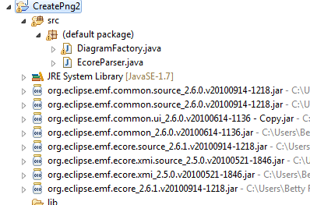
How to unit test of DiagramFactory: Set up the environment – part 1
Download from SVN the most recent DiagramFactory.java and EcoreParser.java to a new Project in Eclipse (that has emf installed)
Add the additional .jar files that you need for this to compile

Slide 23
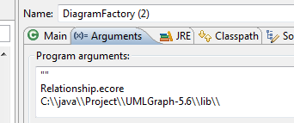
How to unit test of DiagramFactory: Set up the environment – part 2
DiagramFactory includes a “main” that can be used as a unit test.
Setup the args for main in Eclipse:
Run->RunConfigurations->Arguments
Where you put one arg per line
Arg1: represents the path from this dir to where the files will be located (I used “” as I put the ecore file at same level as src pkg)
Arg2: name of the ecore file at that path
Arg3: path of the location of the UMLGraph.jar on your laptop
(please follow the instructions for UMLGraph.jar on how to install on your laptop. Attention: Copy tools.jar from local java directory (e.g. C:\Program Files\Java\jdk1.7.0\lib), put tools.jar and UmlGraph.jar in the same directory
(Also Remember that on windows, sometimes you have to use \\ instead of just \ for path names.)

Slide 24
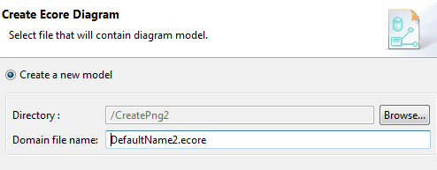
How to unit test of DiagramFactory: Create an ecore file –part 1
Using Eclipse:
File->New->EcoreDiagram
In the tab, give it the directory of your project (For me it was CreatePng2)

Slide 25
How to unit test of DiagramFactory: Create an ecore file –part 2
Within that directory it will create two files:
<Filename>.ecore
<Filename>.ecorediag
Double click on the <Filename>.ecore.diag
(Hint: you might have to do:
Window->OpenPerspective->Other->Ecore)
This should display an area as shown on next page:

Slide 26
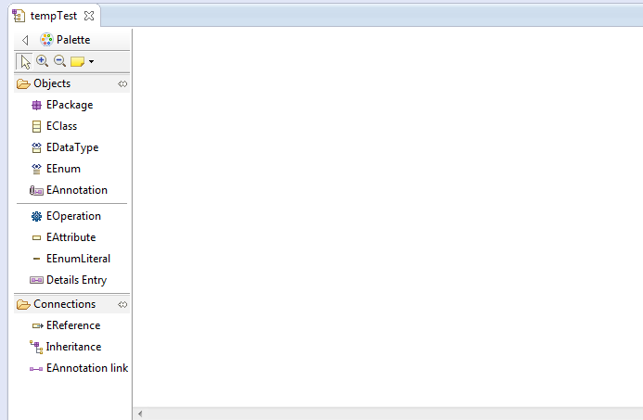
How to unit test of DiagramFactory: Create an ecore file –part 3
To create a diagram, click on an object in the palette (such as Eclass), then click on a spot on the canvas.
After editing, use File-Save

Slide 27
How to unit test of DiagramFactory: Running DiagramFactory
In your project Explorer (left side) double click on DiagramFactory.
Now you should be able to edit the parameters in Run- RunConfigurations as described earlier.
Enter your new ecore file name as the second parameter, and click run. Also, you might want to use Window->OpenPerspective to shift back to a Java perspective if you are debugging the file.
The .png file will be created in the same directory as your src pkg . It might not show up in your project explorer, you will need to use Windows explorer to find the correct folder in your Eclipse workspace.
Enjoy and have fun

